Slide 1
HOME LOAN
Done By: Sai Chaitanya Nettam Nagasai Komal P Tejaswini A Sumeet Ahirwar

Slide 2
PROBLEM STATEMENT – HOME LOAN
Availing loan is a very long and cumbersome process in India. The whole procedure of loan approval may take weeks or even months. We provide a hassle-free user-friendly online platform to our users through which they can apply for loans based on their own requirements and also keep a track of their status and record during the entire process of their loan term without visiting any bank branch. Our system increases customer retention and simplifies loan and EMI management. Our project is designed to be used by any individual for home loan. Our customers can view available services, policies, benefits and other information related to a specific loan. The system collects the required information about the individual and then verifies if they satisfy the eligibility criteria based on which the loan gets approved or rejected.

Slide 3
ROLES
Sai Chaitanya Nettam (Team Lead) : Admin, Income Details
Nagasai Komal P : EMI calculator, Check Eligibility, Email
Tejaswini A : Login,Register
Sumeet Ahirwar : Get a Call Back, About Us, FAQ’s,,Session handling

Slide 4
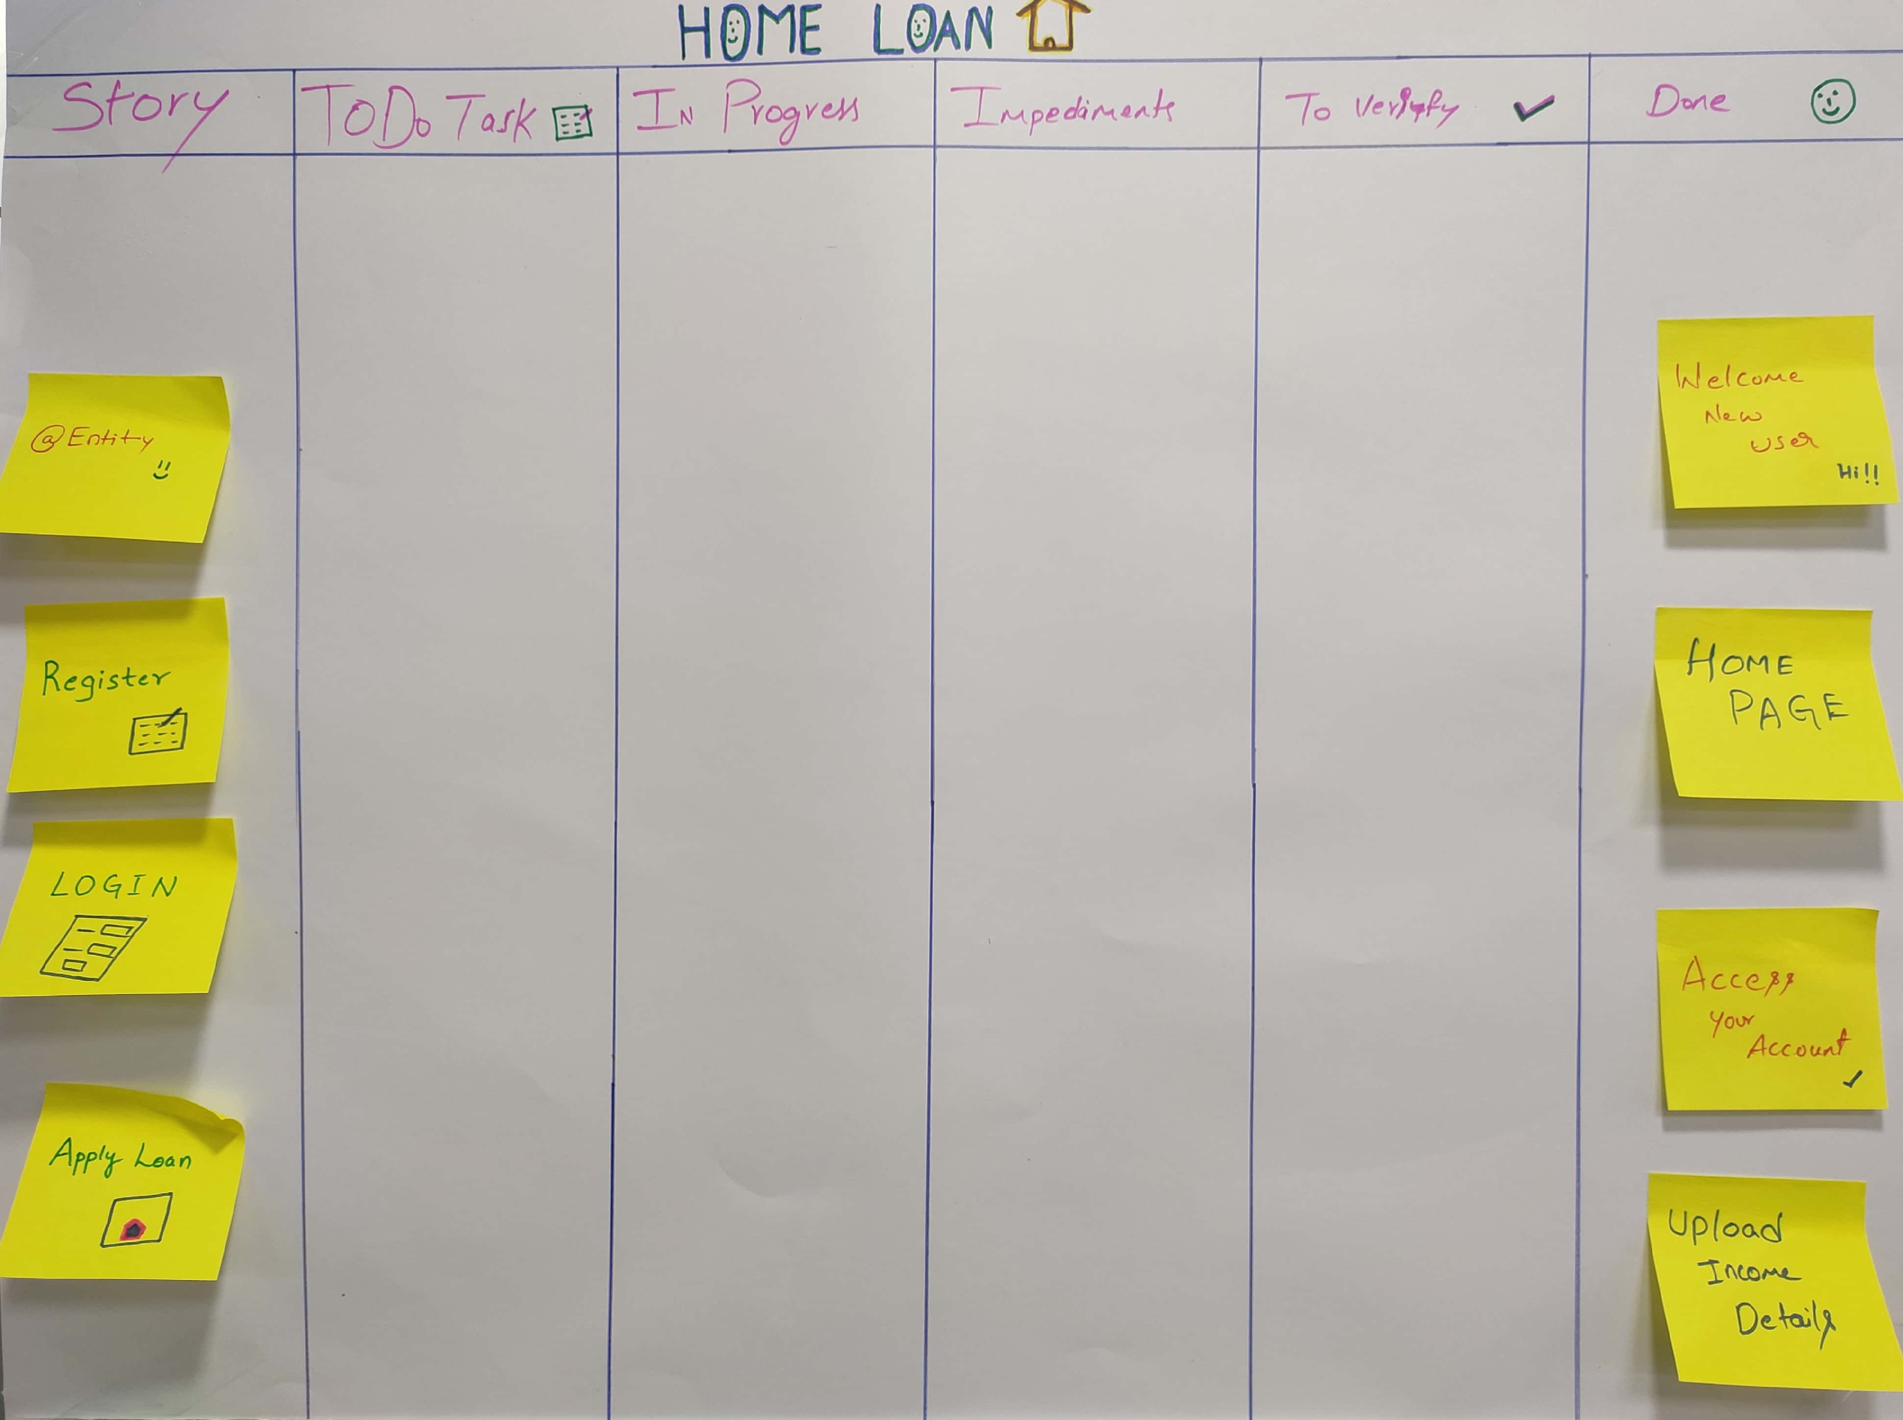
SCRUM 1

Slide 5
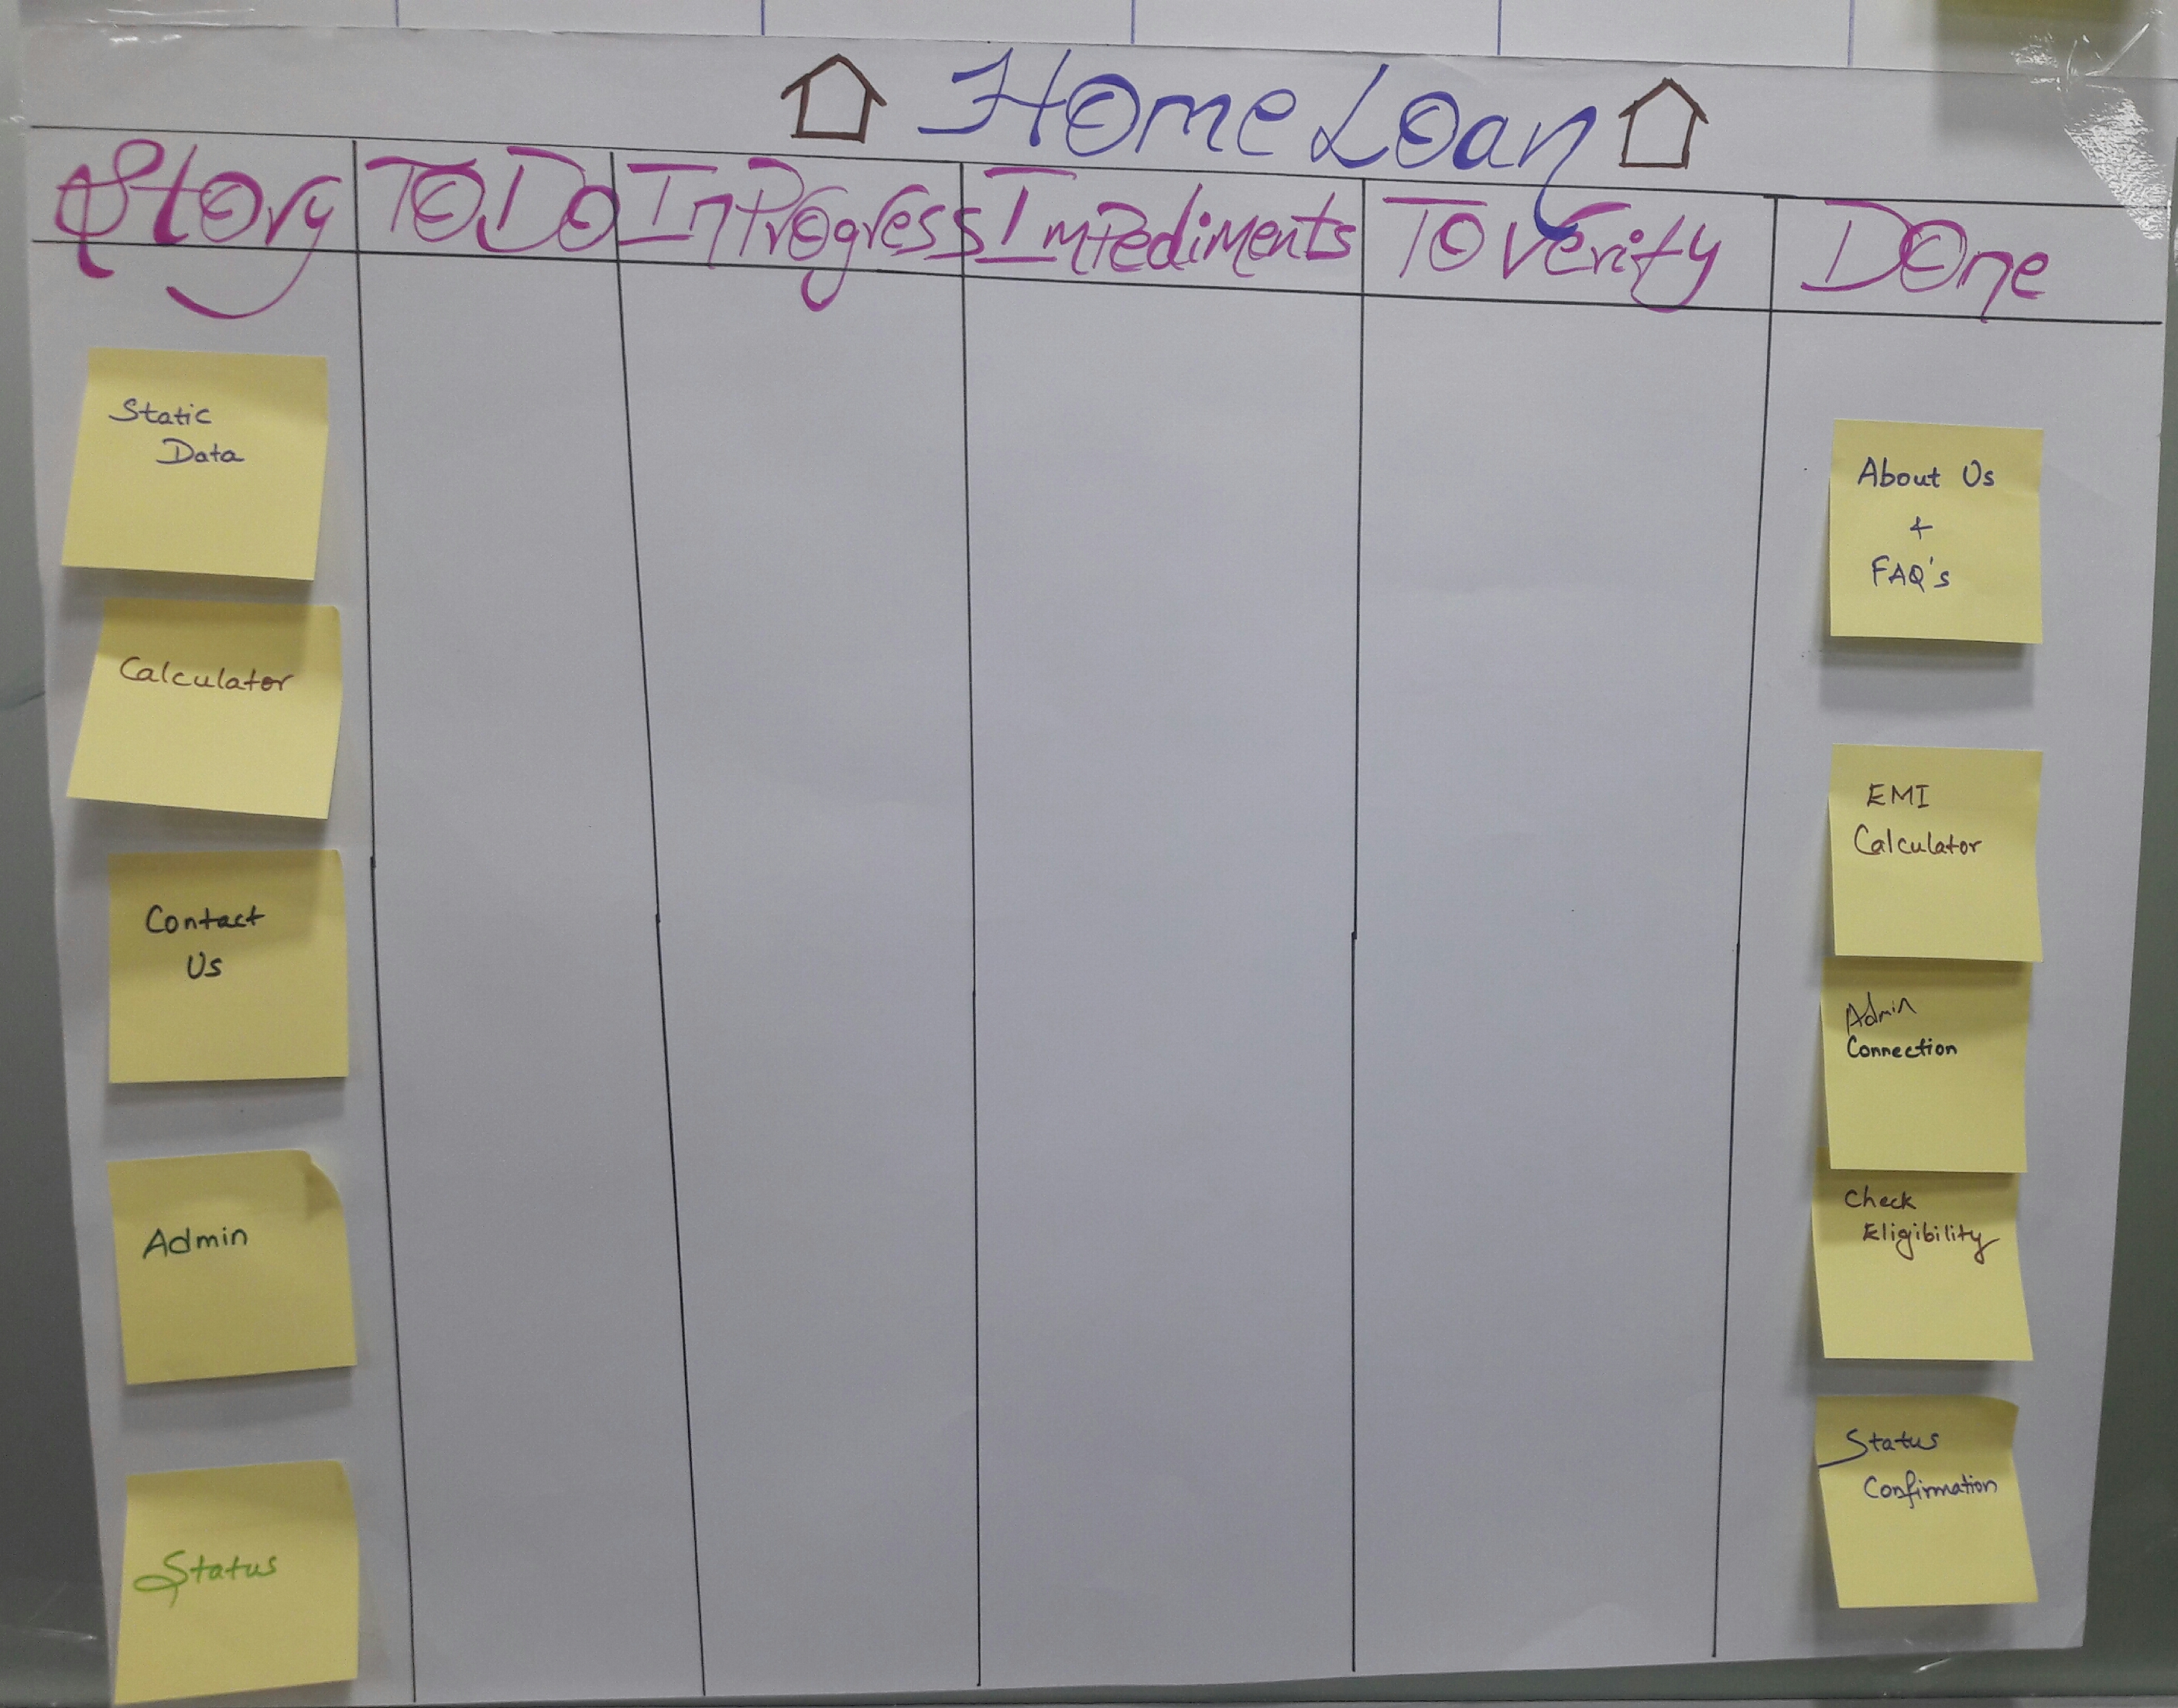
SCURM 2

Slide 6
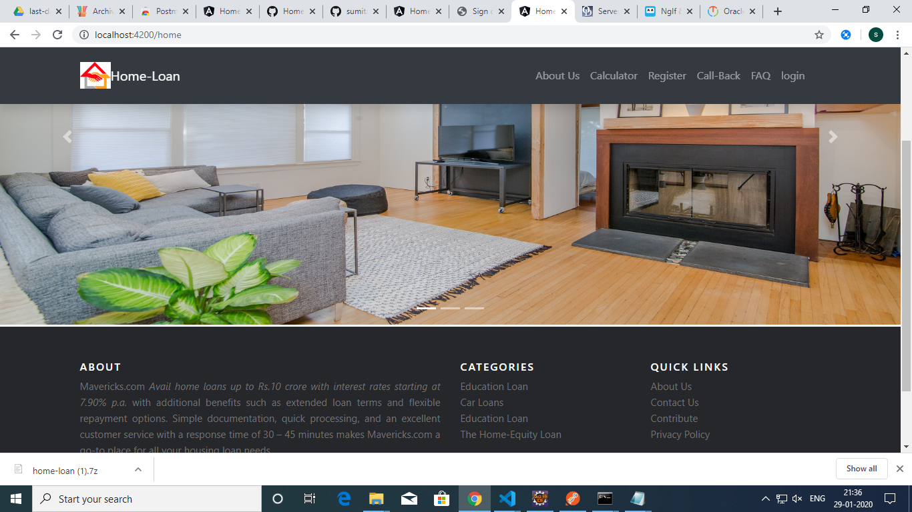
HOMELOAN –Home Page

Slide 7
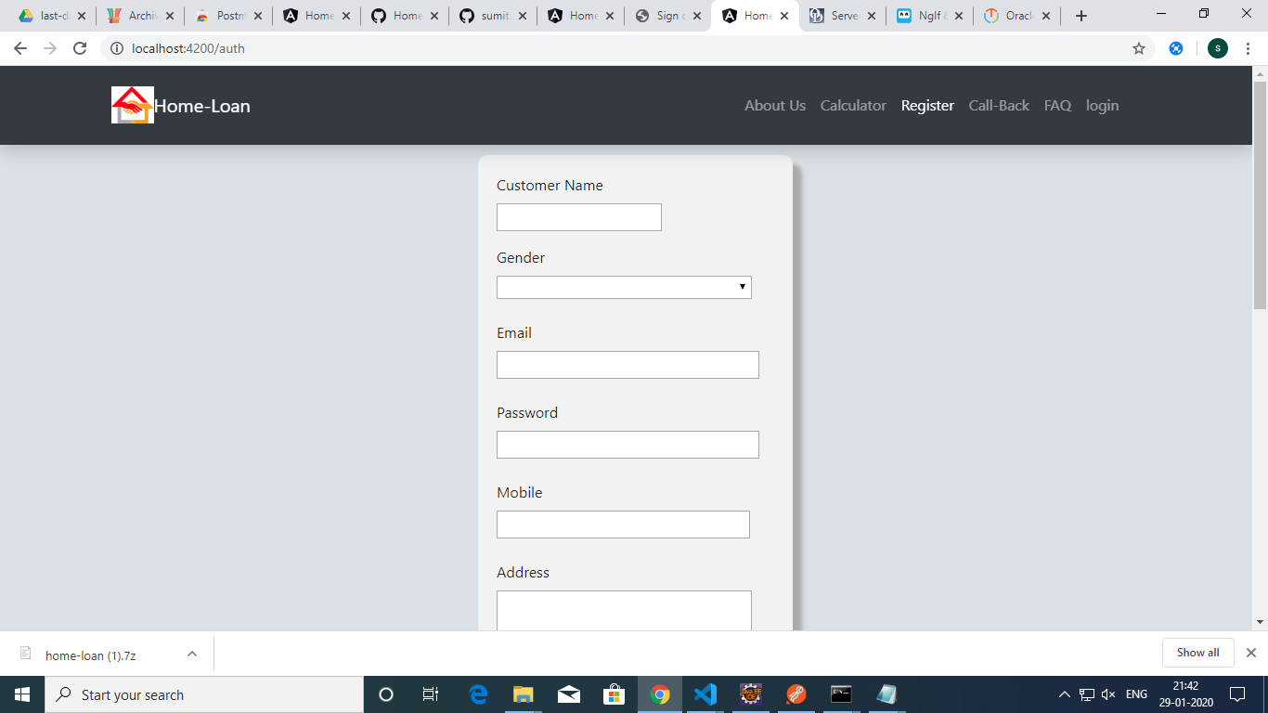
REGISTRATION

Slide 8
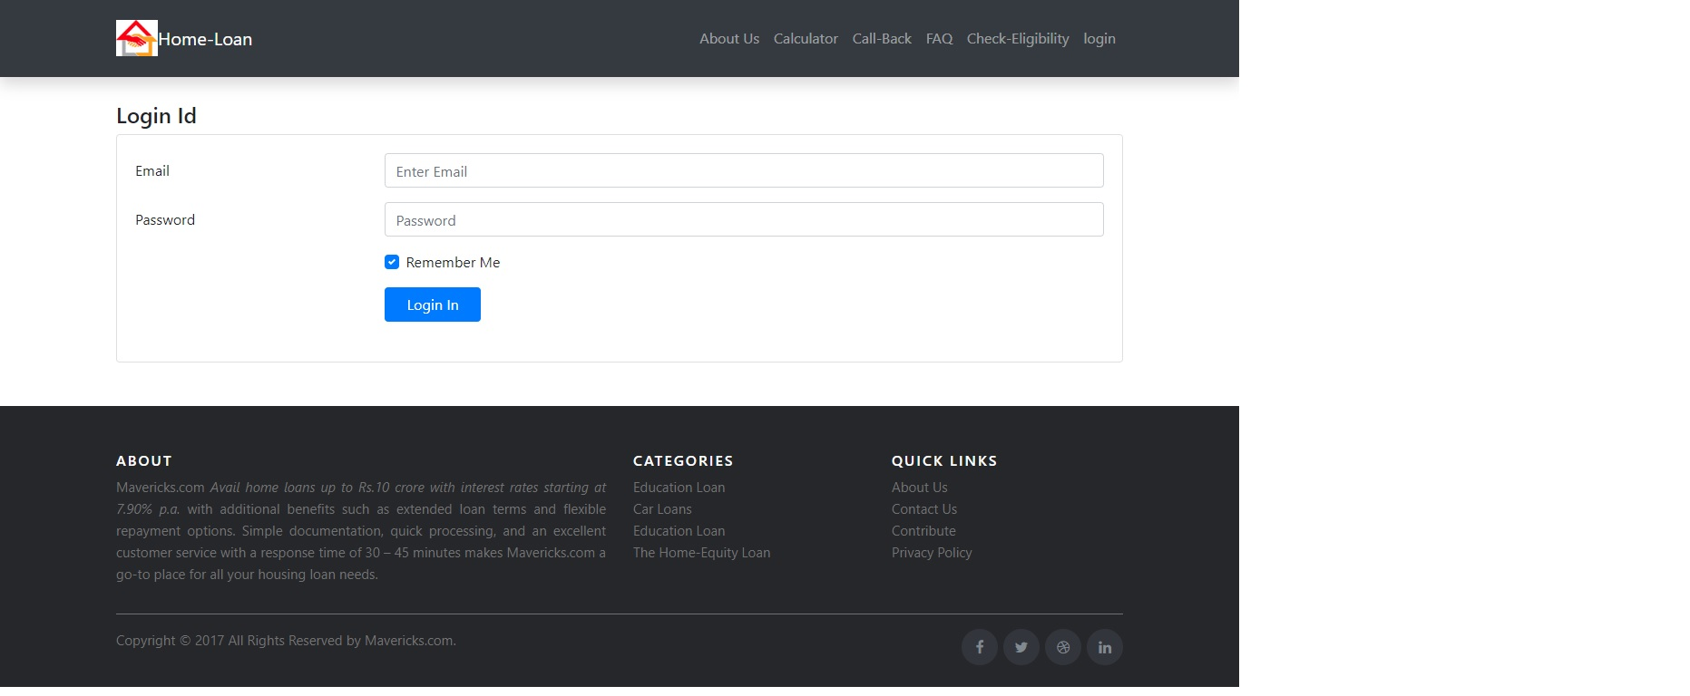
USER AUTHENTICATION

Slide 9
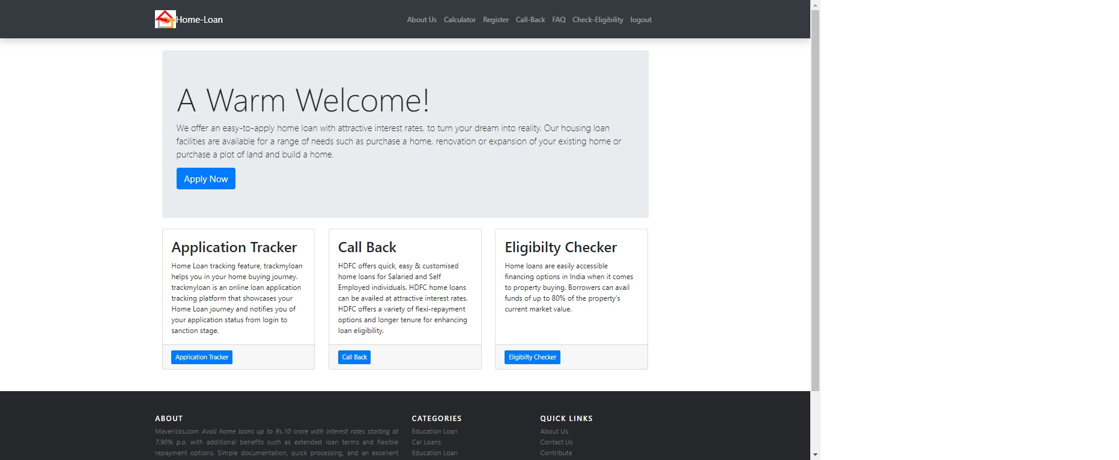
LOGIN PAGE

Slide 10
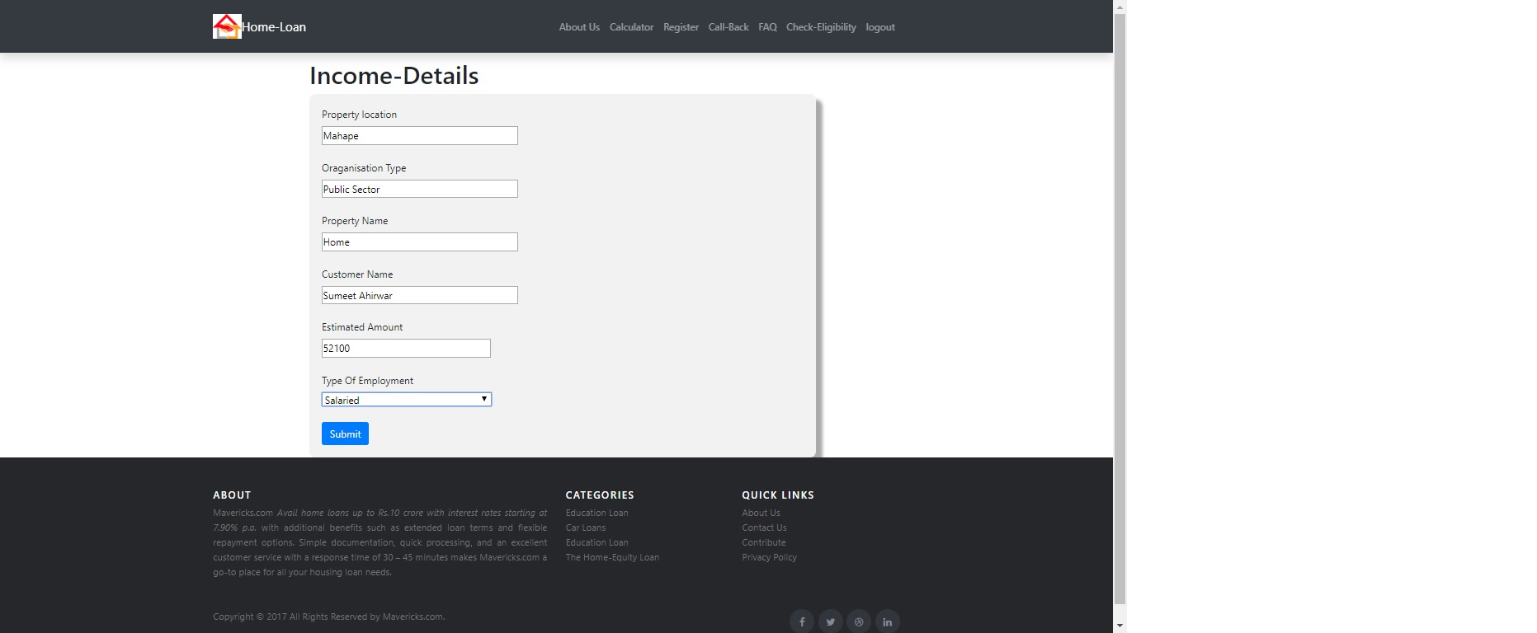
INCOME DETAILS

Slide 11
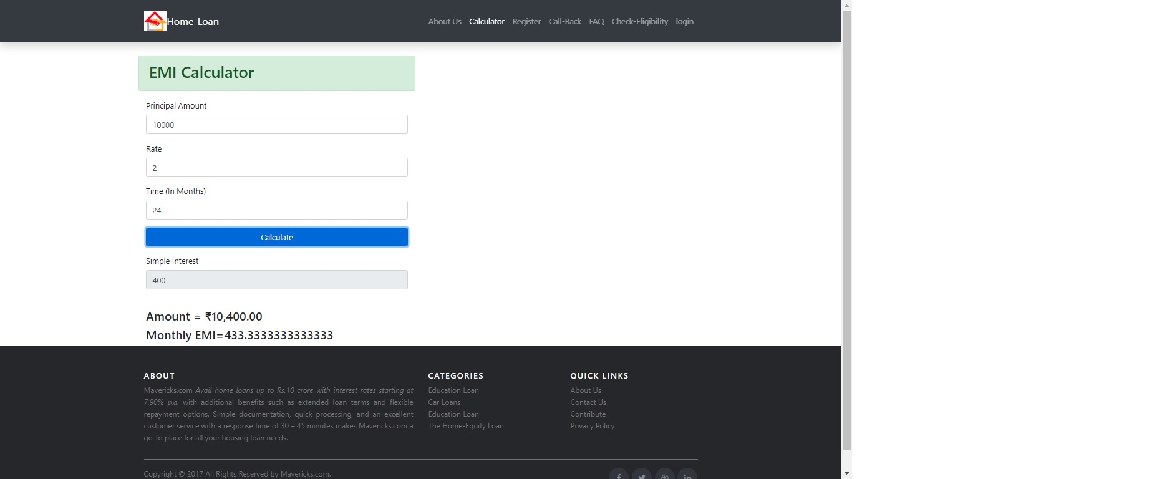
EMI CALCULATOR

Slide 12
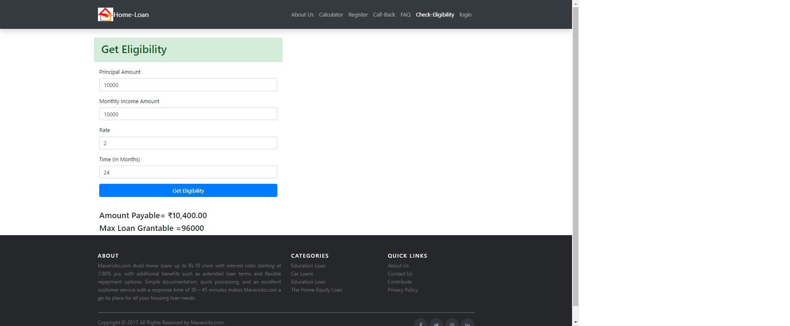
ELIGIBILTY CALCULATOR

Slide 13
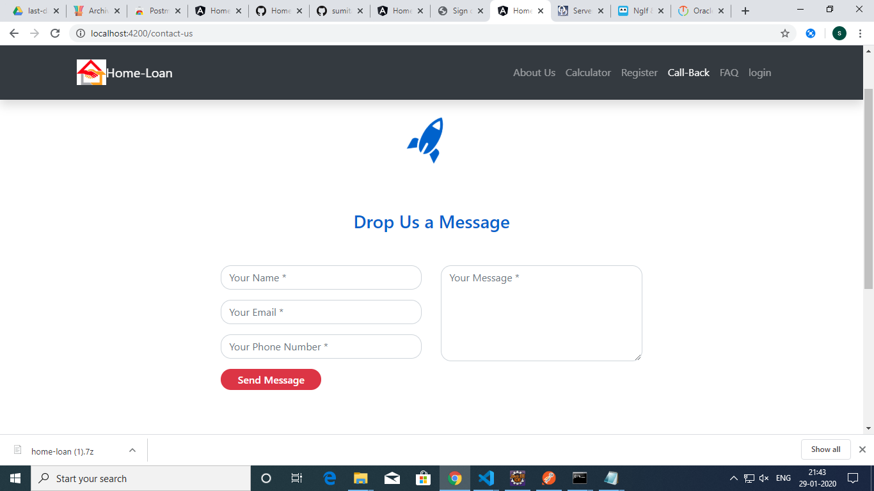
CALL BACK

Slide 14
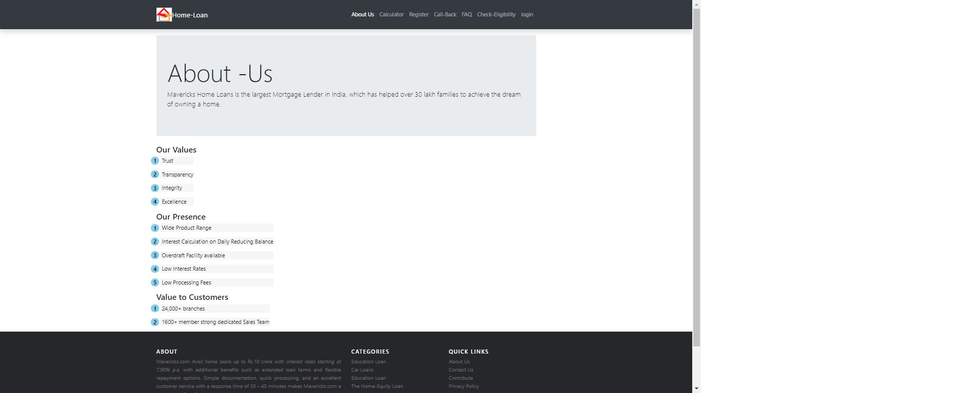
ABOUT US

Slide 15
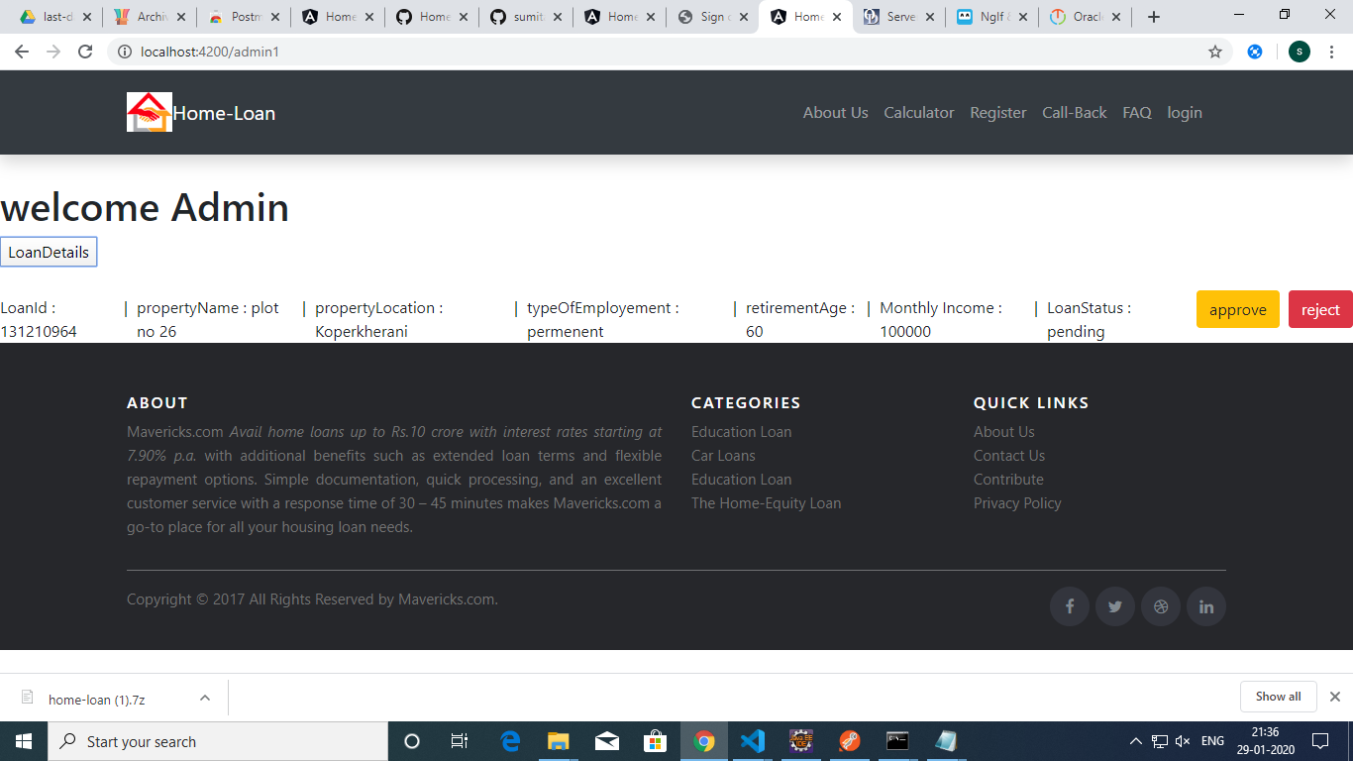
ADMIN

Slide 16
